Slide 1

SHAREMED
International Workshop 12-13 September 2022
The SHAREMED Study Site concept and portals
F. Brunetti (1), V. Faure (2), A. Galea (3)
Istituto Nazionale di Oceanografia e Geofisica Applicata – OGS
M.I.O. Mediterranean Institute of Oceanography / Aix-Marseille University
L – Università Malta
Programme co-financed by the
European Regional Development Fund
Programme cofinancé par le Fonds
européen de développement régional

Slide 2

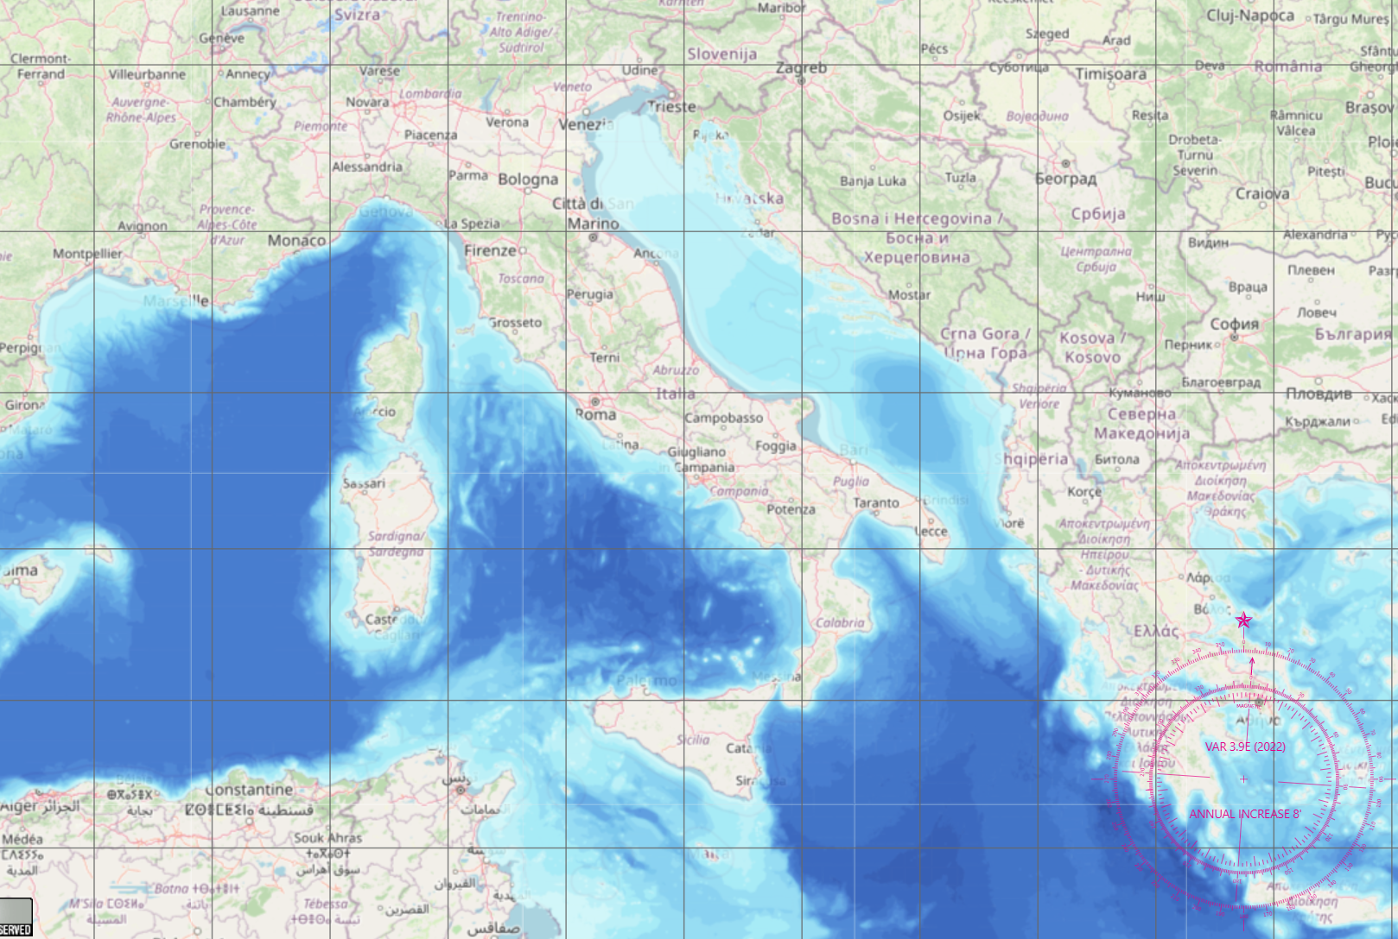
SHAREMED Study Site Concept and Portals
One of the objectives of the SHAREMED strategic project is to integrate existing observing infrastructures into a common transnational system of systems and jointly disseminate observations through common portals.
To provide an application demonstration of what the project has developed, three transnational pilot sites with different characteristics were selected from the beginning of SHAREMED: NorthAdriatic , NorthWestMeD, Sicily Channel
North Adriatic
North West Med
Sicily Channel

Slide 3
SHAREMED Study Site Concept and Portals
A geoportal was developed for each site, collecting data from different sources and making them available to the public.
The work of harmonization and data assimilation of the different data sources allowed to integrate in the portals:
real time data from fixed observational systems for physical, chemical and biogeochemical parameters,
network of transnational systems of HF radar for surface current,
high resolutions satellite products,
relocatable high res phy & biogeochemical short term forecast systems.

Slide 4
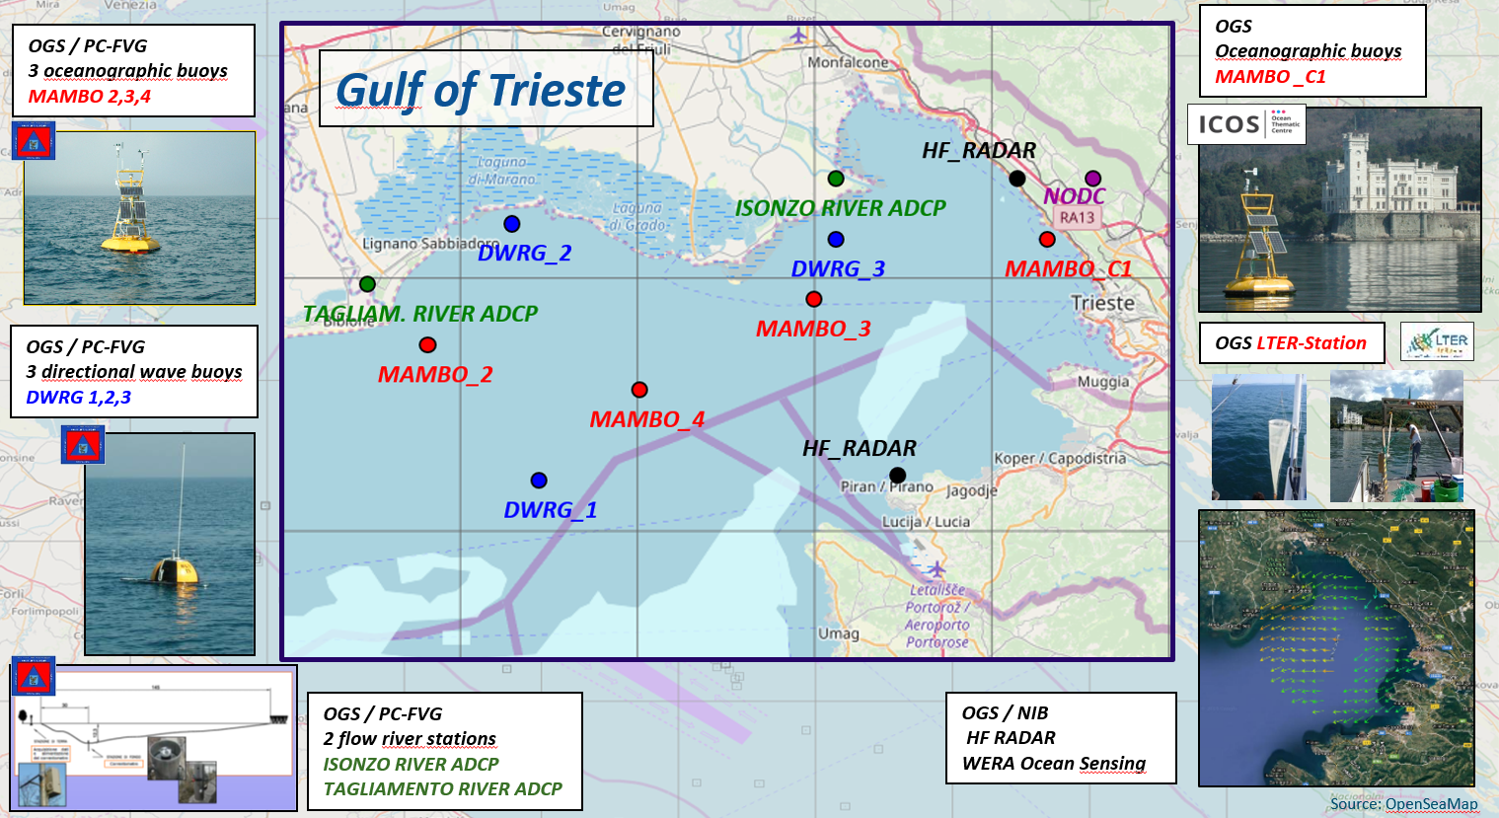
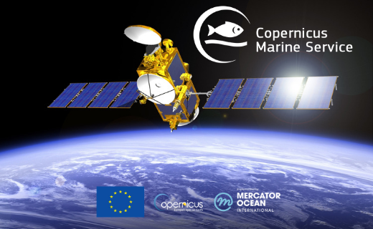
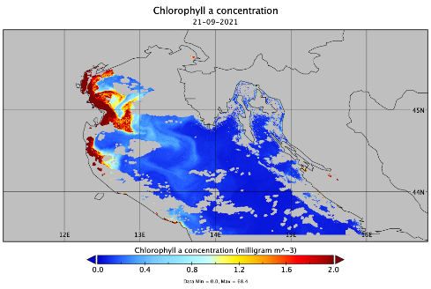
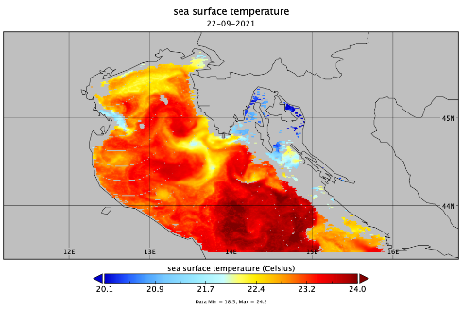
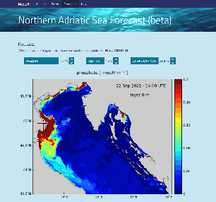
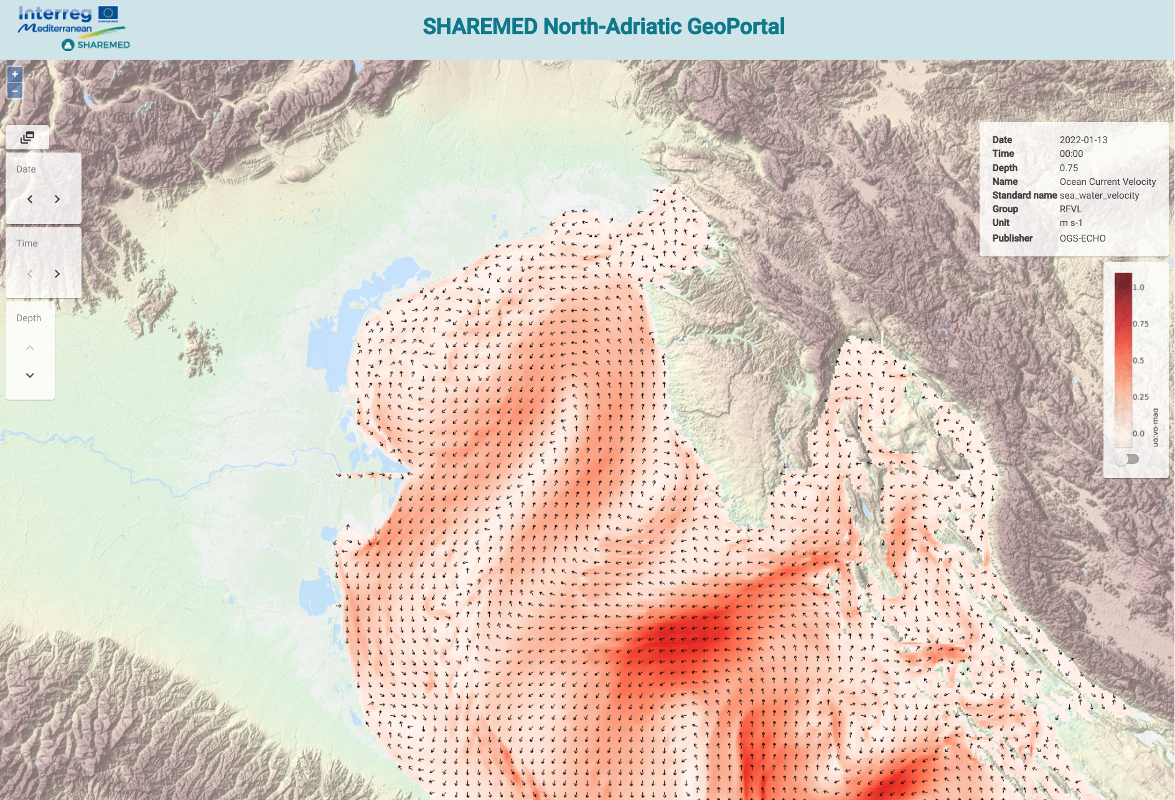
SHAREMED Northern Adriatic – Study Site
WEB Portal
real-time data from fixed platform like HF radar, wave buoys, ADCP and meteo oceanographic buoys
satellite products
SHAREMED North Adriatic Geo Portal
data and products have been collected on a public and shared web portal:
real time plots
satellite images
forecast maps
Northern Adriatic Sea
forecasting system

Slide 5
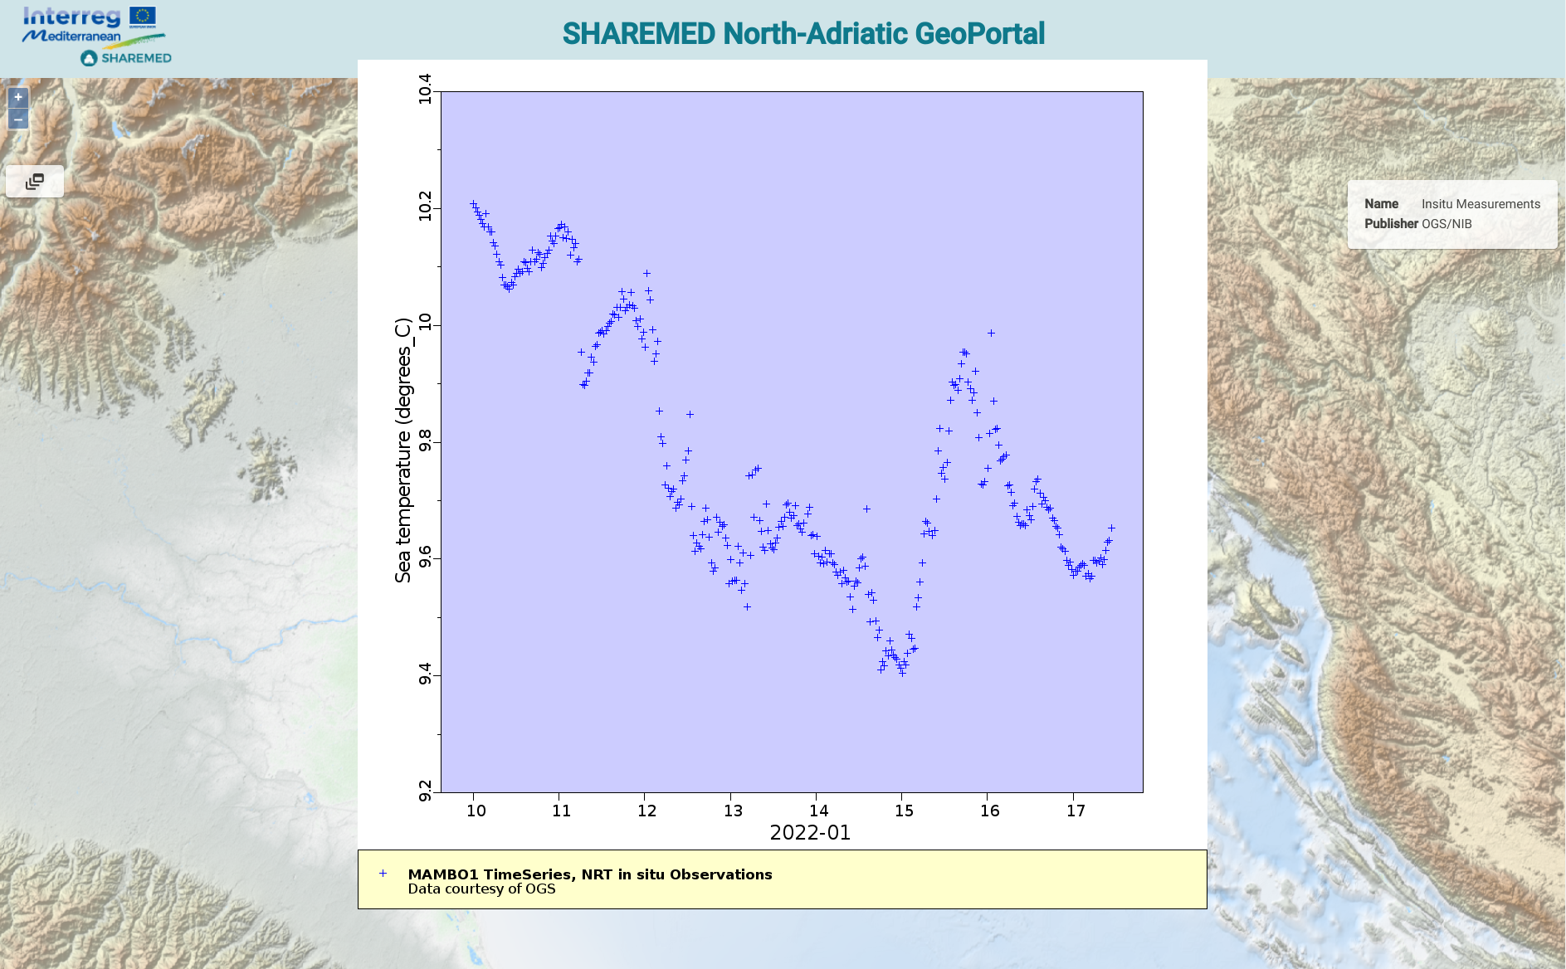
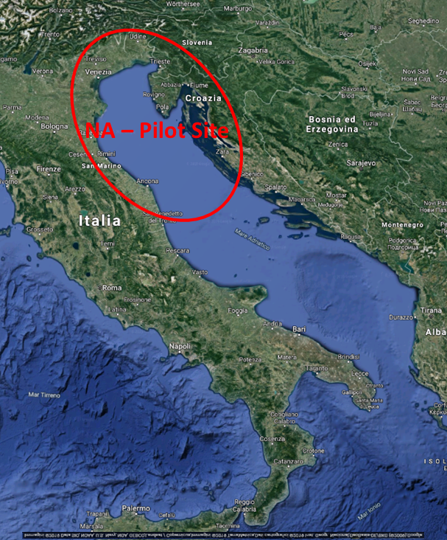
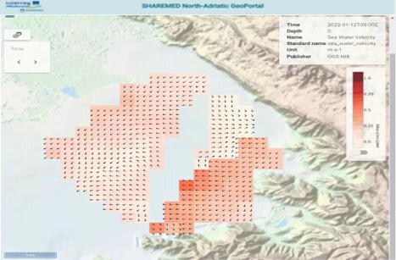
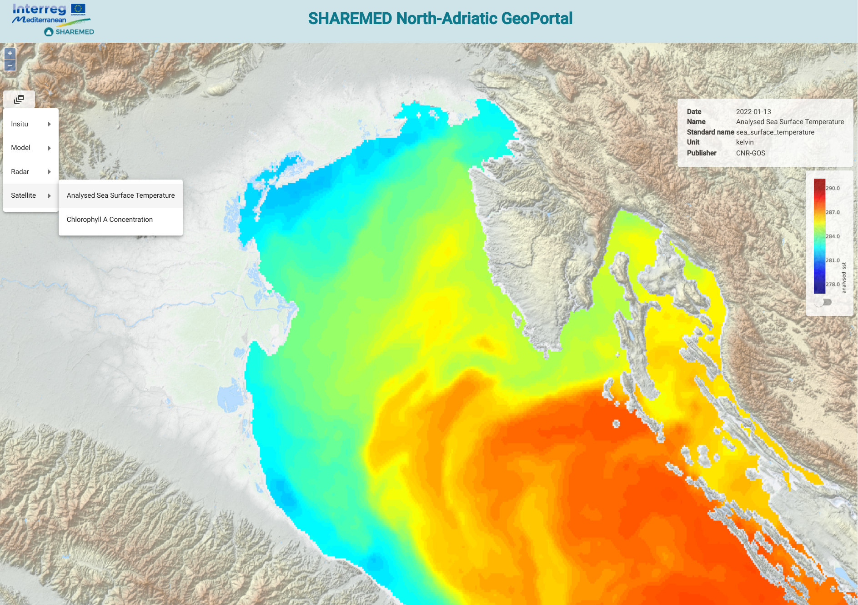
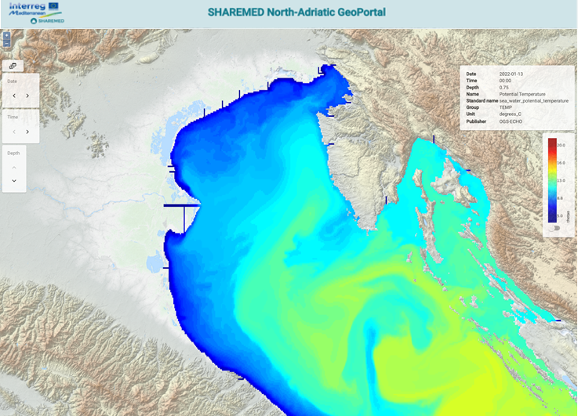
SHAREMED Northern Adriatic – Study Site
WEB Portal
https://sharemed-northadriatic-geoportal.ogs.it/
Real Time Data
Surface Current Map
Satellite Maps
Model Maps

Slide 6
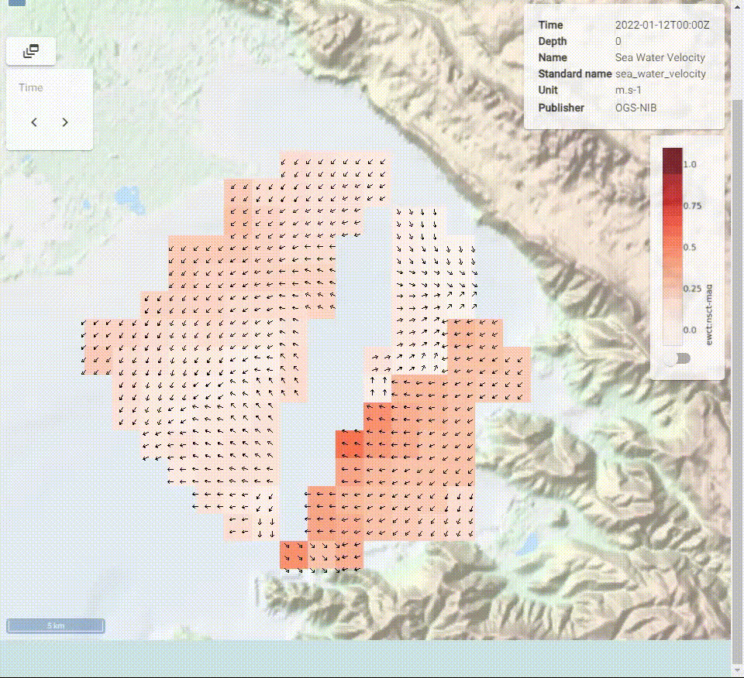
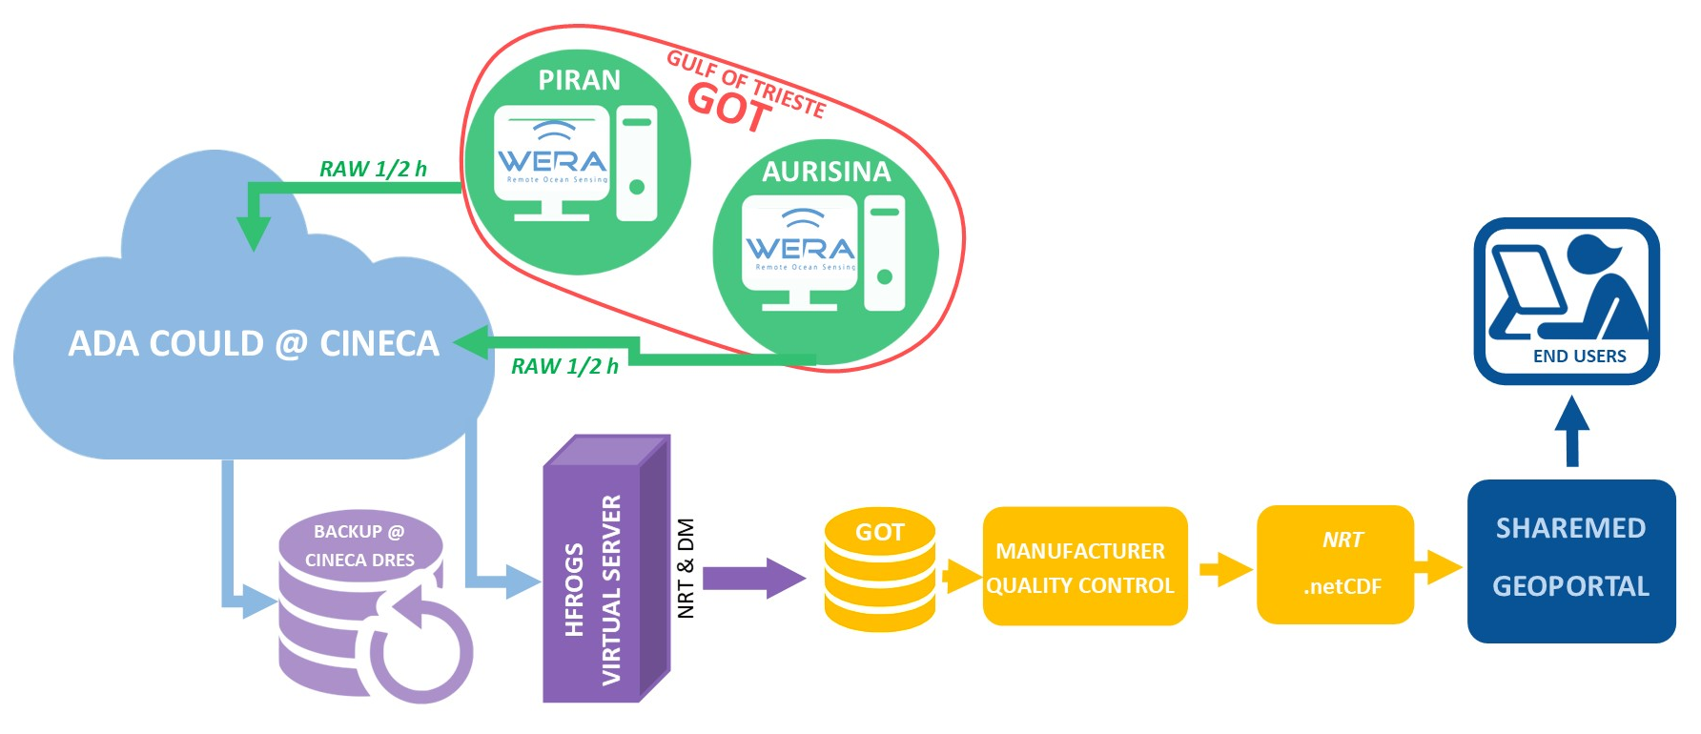


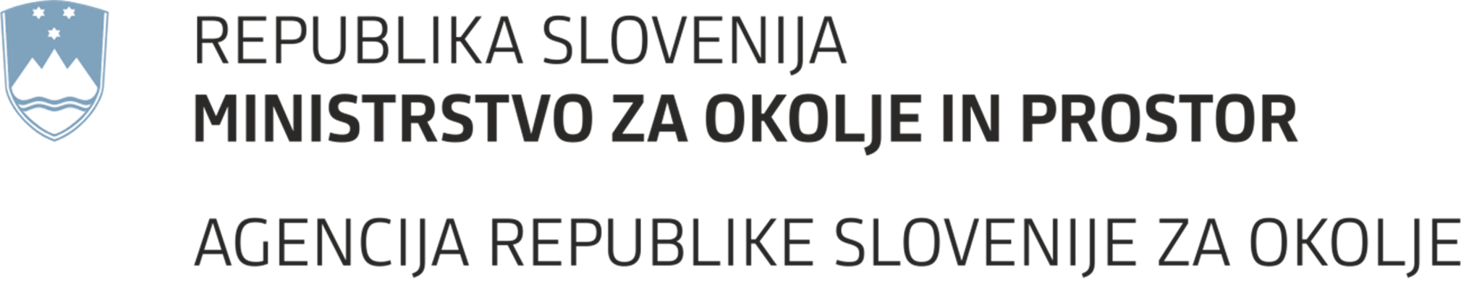
SHAREMED Northern Adriatic – Study Site
Nadr High frequency radar array
A partnership between Italian and Slovenian research centers
SHAREMED GEOPORTAL: HFR LAYER VIEW - Example: Real time current map
24 MHz beam forming WERA system.
Two radar sites as part of the partnership with NIB (SLO) and OGS (IT).
Measures 2D sea surface currents and waves in the gulf of Trieste every 30 min (NTR).
HFR TO SHAREMED GEOPORTAL DATA FLOW

Slide 7
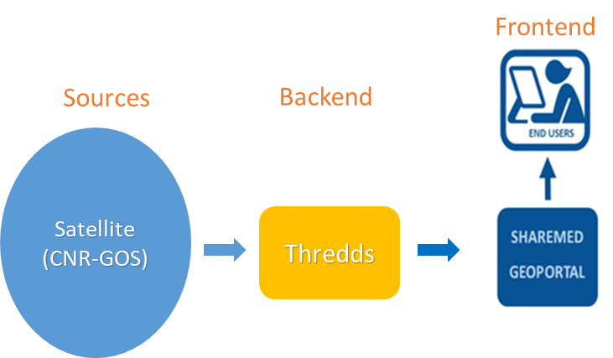
SHAREMED Northern Adriatic – Study Site
Satellite Data and Product
SHAREMED GEOPORTAL: Satellite data layer - Example: Sea surface temperature
SATELLITE DATA TO SHAREMED GEOPORTAL DATA FLOW
Satellite maps are updated once a day.

Slide 8
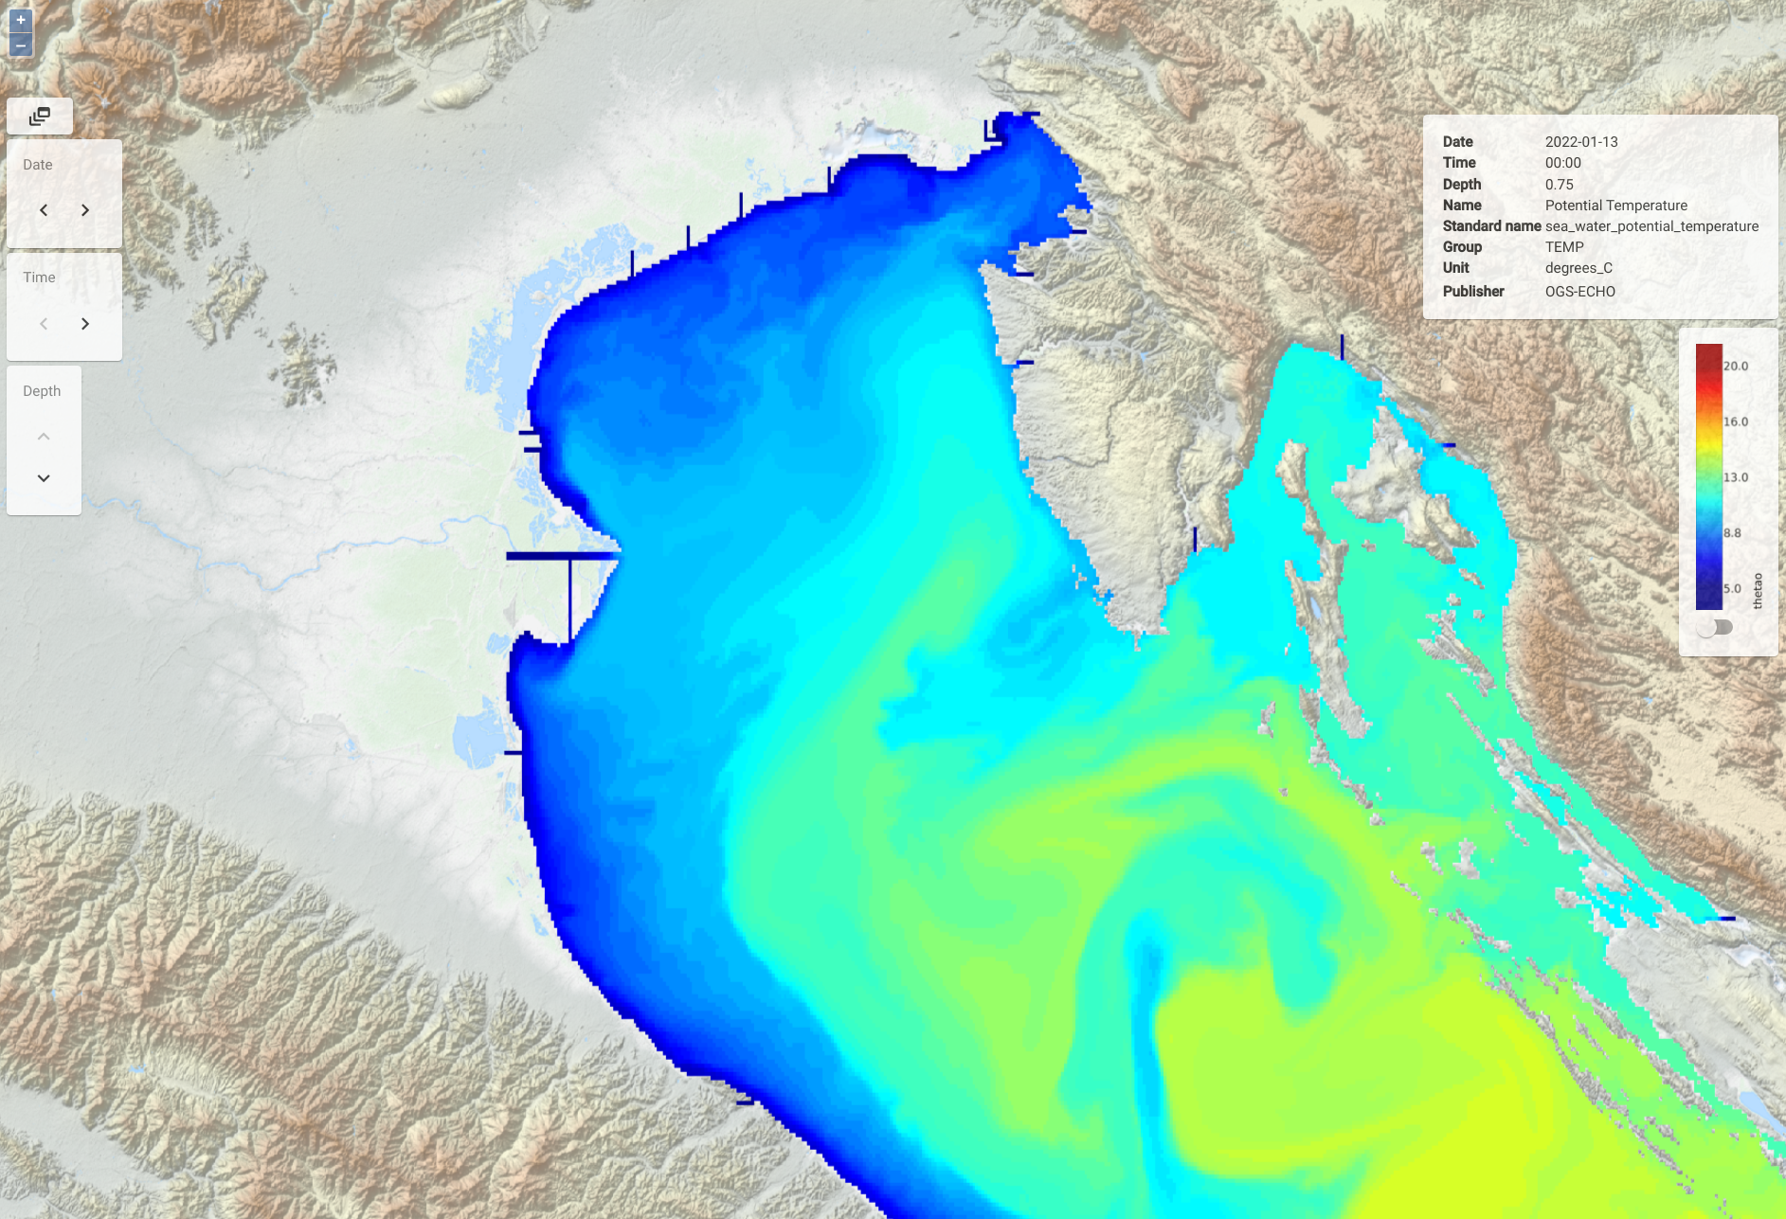
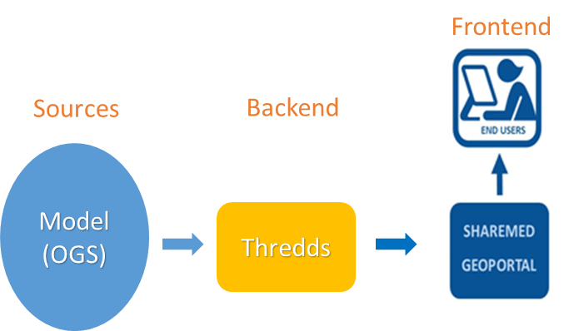
SHAREMED Northern Adriatic – Study Site
Model Data and Product
SHAREMED GEOPORTAL: MODEL LAYER VIEW – Example Potential Temperature
MODEL TO SHAREMED GEOPORTAL DATA FLOW
This layer can be explored on time and depth axis.
Model is updated once a day.

Slide 9
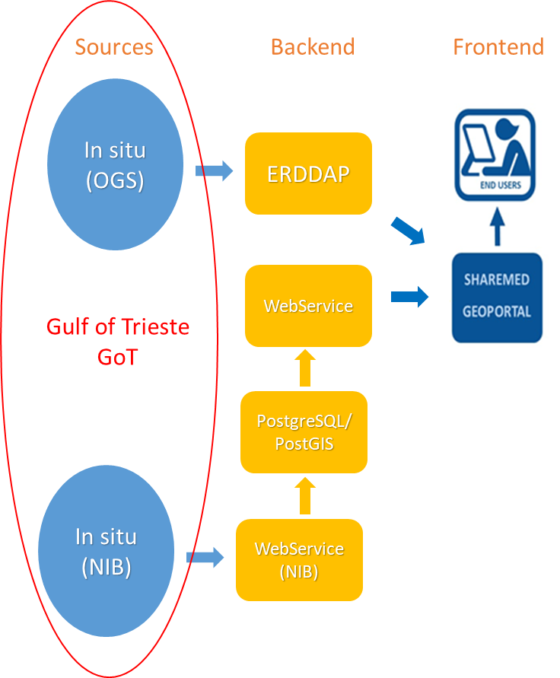
SHAREMED Northern Adriatic – Study Site
Real Time Data
A partnership between Italian and Slovenian research centers
SHAREMED GEOPORTAL: NEAR REAL TIME LAYER VIEW – Example: Sea Temperture @ - 1,5m
REAL TIMA DATA TO SHAREMED GEOPORTAL DATA FLOW
Data are uploaded every 30’.

Slide 10
Thank you

